Slide 1
Object-Oriented Programming (OOP)

Slide 2
Object-Oriented Programming (OOP)
OOP is a programming paradigm that emphasizes the use of objects to organize and structure code.
JavaScript, being a versatile and popular programming language, supports OOP principles through its object-oriented features.
OOP is a programming paradigm based on the concept of "objects."

Slide 3
Object
An object is a self-contained unit that encapsulates data (properties) and behaviors (methods).
It promotes the reusability, maintainability, and modularity of code.

Slide 4
Class
Class is Like a blueprint from which we can create new objects based on the rules described in the class

Slide 5
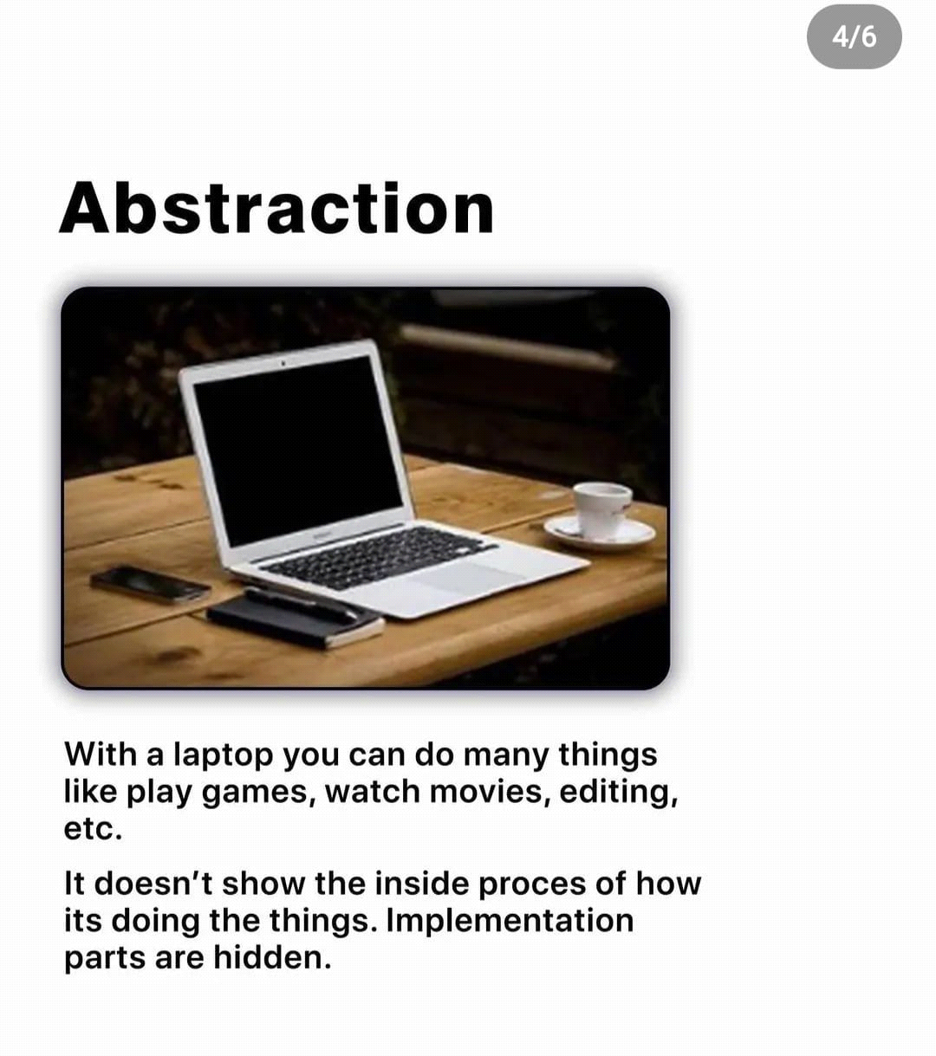
Abstraction:
Abstraction involves simplifying complex systems by breaking them down into smaller, manageable parts. In OOP, abstraction is achieved by defining a class with only the essential attributes and methods, hiding unnecessary details from the outside world.

Slide 6
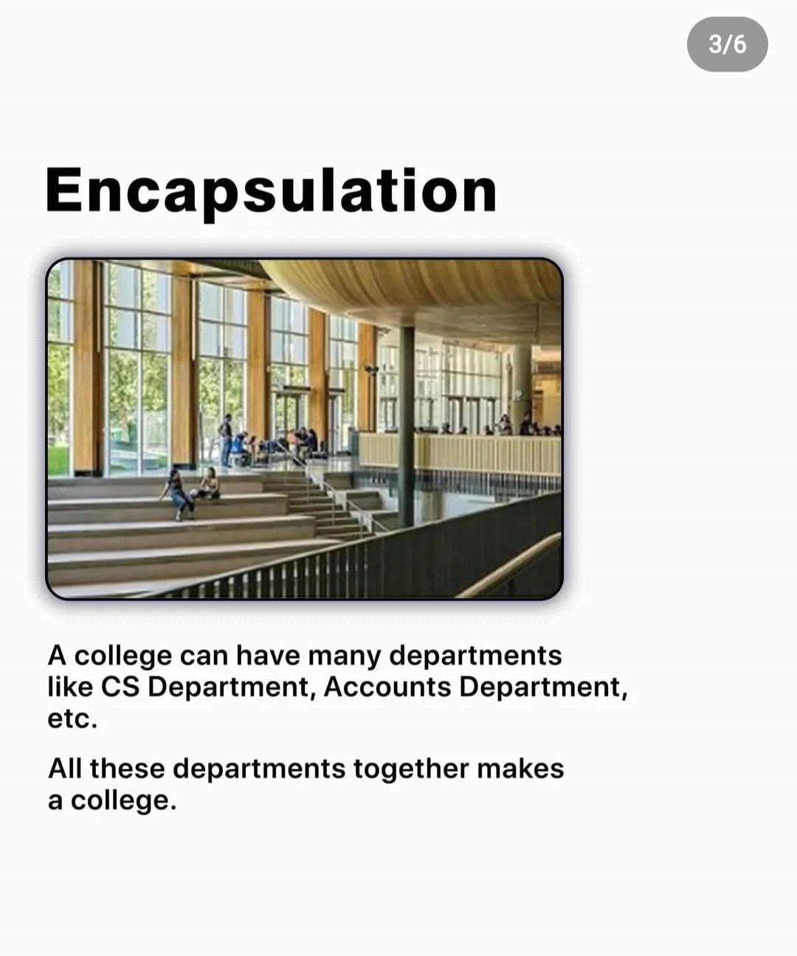
Encapsulation
Encapsulation is the concept of bundling data and methods together within a class, hiding the internal implementation details from the outside world. This way, the class exposes only necessary methods to interact with its data, providing data protection and reducing the risk of unintentional modification.

Slide 7
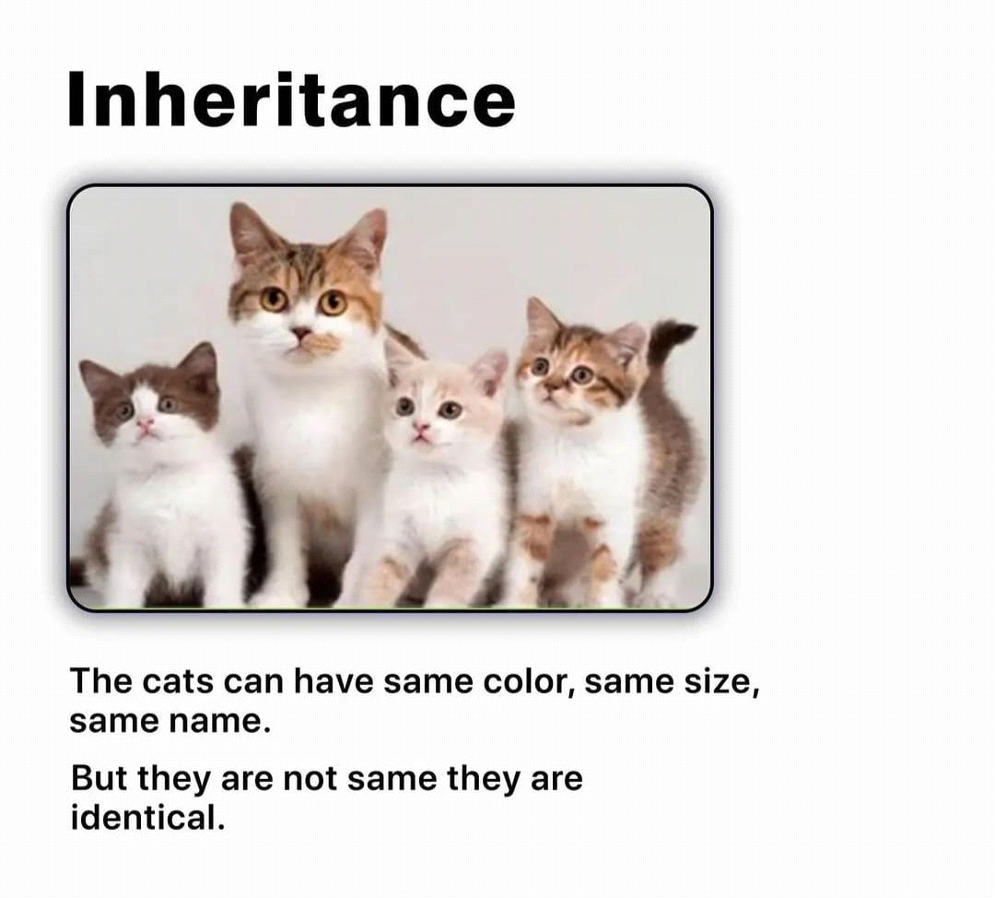
Inheritance
Inheritance allows a class (called a subclass or child class) to inherit properties and methods from another class (called a superclass or parent class).
It promotes code reusability and allows us to create more specialized classes without duplicating code. In JavaScript,
inheritance is achieved using the extends keyword.

Slide 8
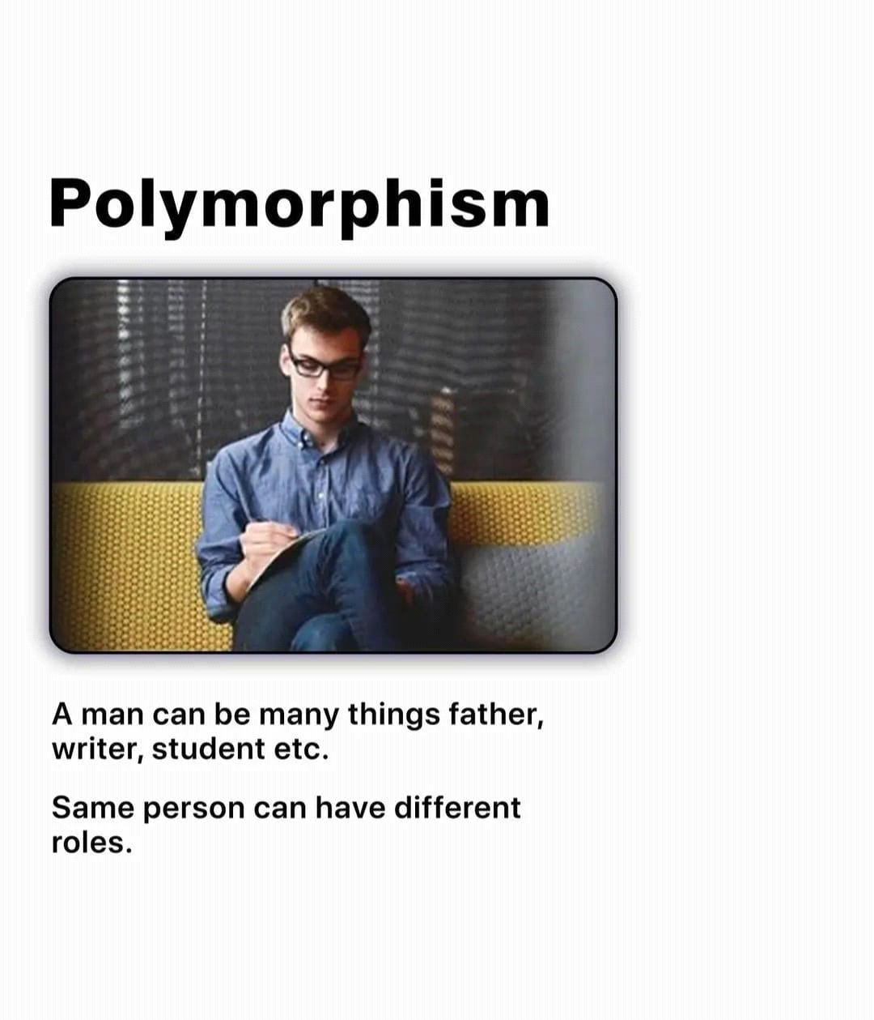
Polymorphism
Polymorphism allows objects of different classes to be treated as objects of a common superclass.
It enables the same method name to behave differently based on the object type. JavaScript, being a dynamically-typed language, naturally supports polymorphism. You can invoke the same method on different objects, and the appropriate implementation will be executed based on the object's type.

Slide 9
Class Creation
To define a class, you use the class keyword followed by the name of the class. Inside the class body, you can declare properties and methods that belong to the class.

Slide 10
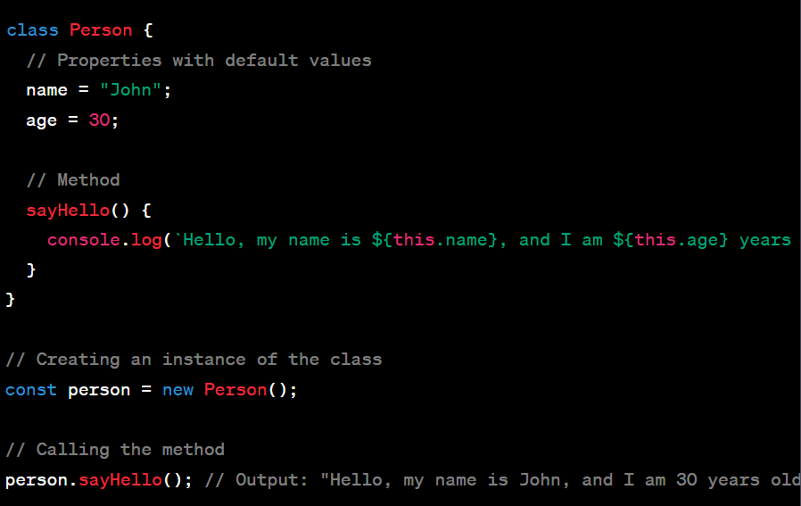
Example of Class

Slide 11
What is this?
In JavaScript, the this keyword refers to an object.
Which object depends on how this is being invoked (used or called).
The this keyword refers to different objects depending on how it is used:
In an object method, this refers to the object.
Alone, this refers to the global object.
In a function, this refers to the global object.
In a function, in strict mode, this is undefined.
In an event, this refers to the element that received the event.

